Slide 1

HOUSE PRICE PREDICTION PROJECT
Submitted by:
MOHAMMED ZAHED N

Slide 2
Agenda
1. Problem statement
2. Understanding
3. EDA
4. Visualizations steps
5. Observations
6. Conclusion

Slide 3
Problem statement
You are required to model the price of houses with the available independent variables. This model will then be used by the management to understand how exactly the prices vary with the variables. They can accordingly manipulate the strategy of the firm and concentrate on areas that will yield high returns. Further, the model will be a good way for the management to understand the pricing dynamics of a new market.

Slide 4
Understanding
House Price:
Houses are one of the necessary needs of each and every person around the globe and therefore housing and real estate market is one of the markets which is one of the major contributors in the world’s economy. It is a very large market and there are various companies working in the domain. Data science comes as a very important tool to solve problems in the domain to help the companies increase their overall revenue, profits, improving their marketing strategies and focusing on changing trends in house sales and purchases. Predictive modelling, Market mix modelling, recommendation systems are some of the machine learning techniques used for achieving the business goals for housing companies. Our problem is related to one such housing company.

Slide 5
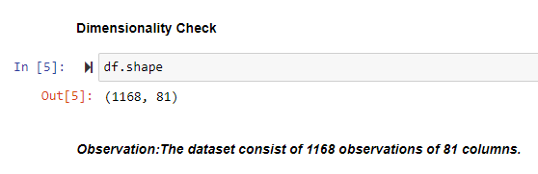
EDA(Exploratory Data Analysis
Checking Dimensionality:

Slide 6
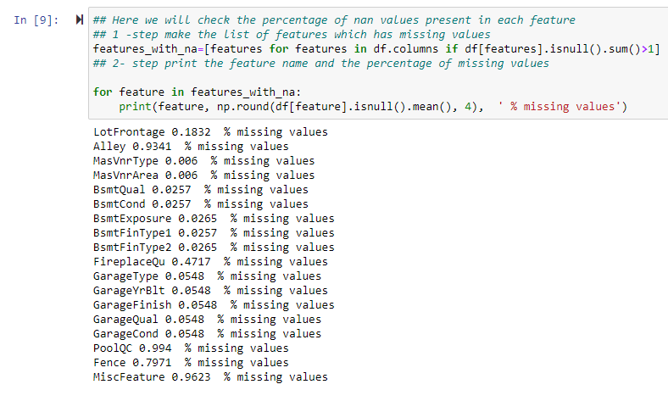
Checking Missing Values:

Slide 7
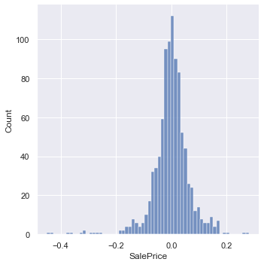
Visualizations steps
This is a visualisation for the predicted values using Random Forest Regressor Model after Hyper parameter Tuning
Observation: We can see that the predicted value data is Normally distributed hence the predicted values are accurate we can say

Slide 8
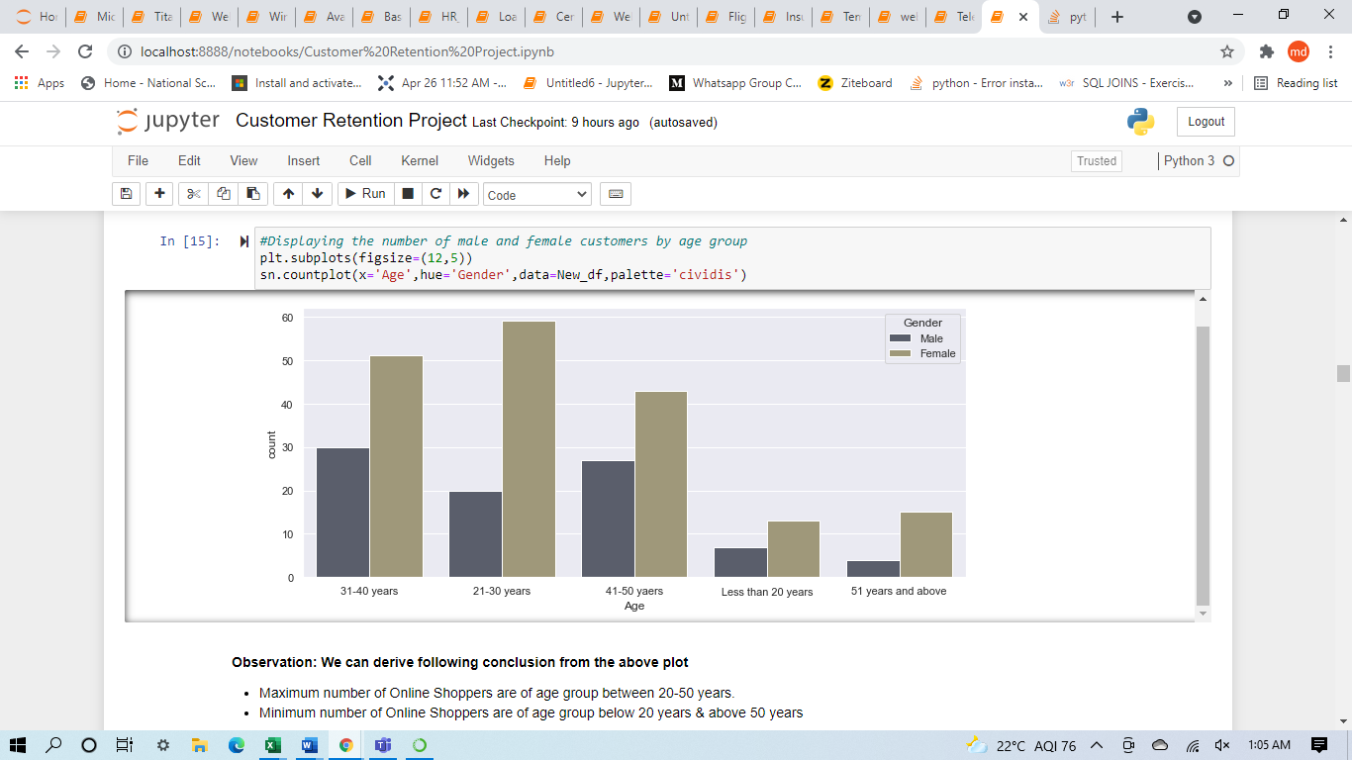
Countplots: Visualisation to see how the data is distributed among the different age groups

Slide 9
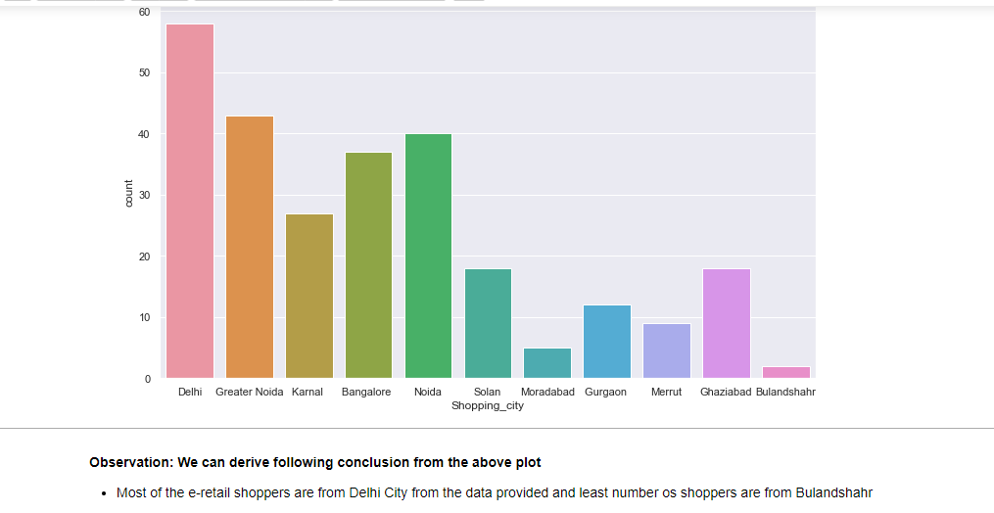
Countplot: Visualisation to see how the customer data is distributed among different cities
Observation: Most of the e-retail shoppers are from Delhi City from the data provided and least number of shoppers are from Bulandshahr.

Slide 10
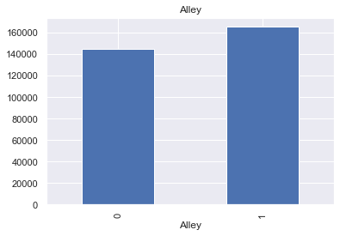
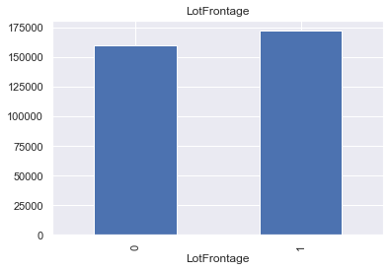
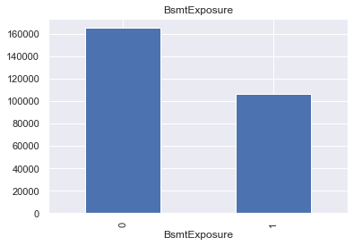
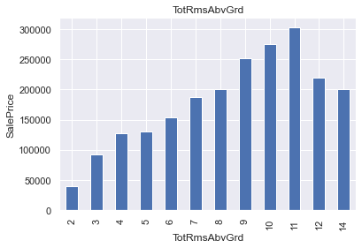
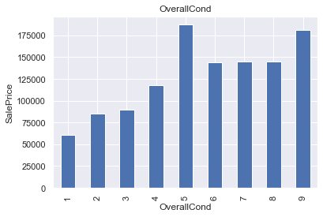
4. Visualizations steps: Some of the visualisations of the barplots for various columns with respect to dependent feature.

Slide 11
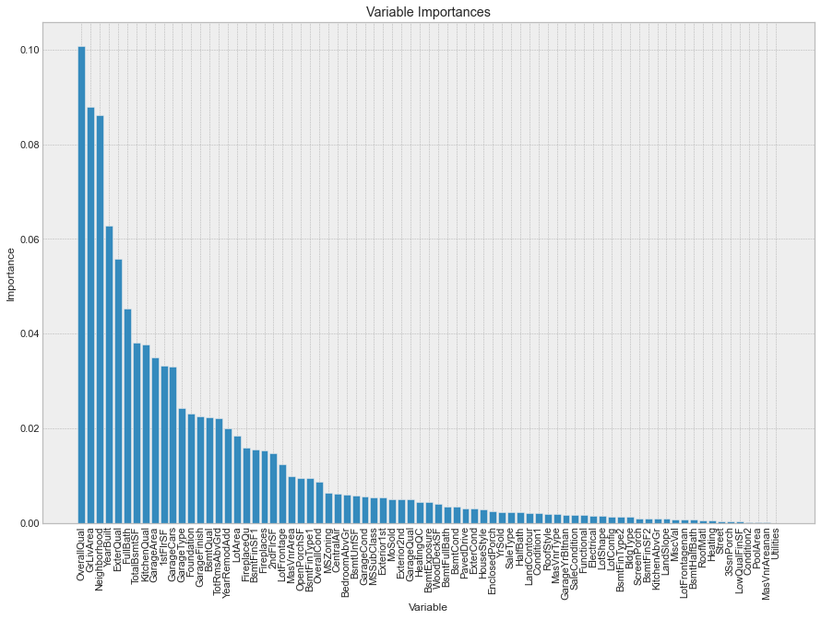
Feature Importance:

Slide 12
Observation: A future aim may be to cut the less relevant features (lets say we can drop some columns in terms of importance), estimate a new model and compare it with the old ones. I reckon it would lose predictive power, but on the other hand it would improve in terms of training speed. In conclusion, these are my final considerations on the model: * The best feature to reliably predict the House price is Type of OverallQual. After OverallQual there is a group of 10 features including: 1 0.088005 GrLivArea * 2 Neighborhood 0.086088 * 3 YearBuilt 0.062831 * 4 ExterQual 0.055818 * 5 FullBath 0.045347 * 6 TotalBsmtSF 0.037992 * 7 KitchenQual 0.037619 * 8 GarageArea 0.034932 * 9 1stFlrSF 0.033212 * 10 GarageCars 0.033007 * 11 GarageType 0.024202 * Utilities is the least relevant feature in this cluster.

Slide 13
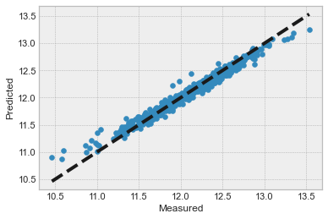
Actual vs Predicted House Price:

Slide 14
Conclusion
Key Findings and Conclusions of the Study
We can see that the actual and predicted house price are aligned with each other Normally distributed which means the model is accurate and predicted values are considerable.
Final Conclusion:
Columns like OverallQual, GrLivArea, Neighborhood, YearBuilt, ExterQual, FullBath, TotalBsmtSF, KitchenQual, GarageArea, 1stFlrSF, GarageCars & GarageType have effect on House Price.
The Actual vs Predicted plot clearly indicates the predicted values are almost linear hence performance of model is considerably Good
Random Forest Regressor model predicts the House price more accurately than Decision Tree.

Slide 15
THANK YOU

